Slide 1
Brain Teaser
A company has 10 machines that produce gold coins. One of the machines is producing coins that are a gram light. How do you tell which machine is making the defective coins with only one weighing?
Why are manhole covers round?

Slide 2
Answers
1 - Think this through - clearly, every machine will have to produce a sample coin or coins, and you must weigh all these coins together. How can you somehow indicate which coins came from which machine? The best way to do it is to have every machine crank a different number of coins, so that machine 1 will make one coin, machine 2 will make two coins, and so on. Take all the coins, weigh them together, and consider their weight against the total theoretical weight. If you're four grams short, for example, you'll know that machine 4 is defective.
2 – A few reasons include:
- Roll it instead of carrying
- Cant fall in the hole unlike a square cover.
- Cant cut yourself on a circle
- Don’t have to line up the corners when installing

Slide 3
Stock Competition Update
Who’s Hot : David – Hewlett-Packard (short)
Benjamin– Facebook
James C – Google
Who’s Not: Spandana – Apple
Patrick – Apple
Luke – Amazon

Slide 4
Current Events

Slide 5
Numbers to Know
Crude Oil (barrel)
$85.85
Gas ($/million BTUs)
$3.48
Gold (troy ounce)
$1701.60
Silver (troy ounce)
$31.62
S&P 500
1409.53
DJIA
13,083.64
Hang Seng
21,763.78

Slide 6
Barnes and Noble
Today, Barnes and Noble (BKS) announced that PIN numbers from debit cards were stolen from over 60 stores
Corporate says that the perpetrators planted bugs in their POS machines, logging the keypresses when the customer was prompted for it.

Slide 7
All PIN pads were disconnected by September 14th, but retail machines were still safe to use
The company says that any customer who used their debit card at a store within the last month should change their PIN number for safety.
Affected stores were all over the country, including CA, NY, FL, IL, MA, NJ, PA, RI.

Slide 8
Federal law enforcement authorities have been notified and are already on the case.
BKS stock dropped today, but there is no indication that this drop is related to the news.

Slide 9
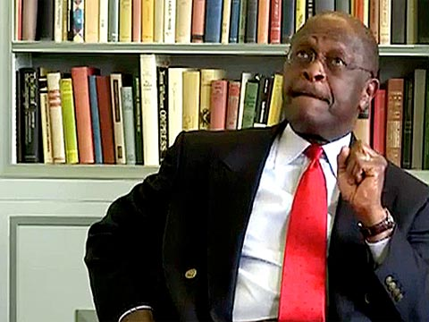
The Personal Elevator Pitch: Interview Like a Champion
A Presentation by Brett Provenzano

Slide 10
So…
Tell me about yourself…

Slide 11
Agenda
What is an elevator pitch
What is in a good pitch
Example Pitch/Critique
How to build an elevator pitch
Your turn!

Slide 12
What is an elevator pitch?
Can be a response to:
Tell me about yourself.
Why are you interested in a particular industry?
Why a certain company?
Why did you choose Cornell or a certain major?
Guidelines
Length: 30 to 60 seconds
Summarize 2 to 3 important “takeaways”

Slide 13
What’s in a good pitch?
Narrative: The story your experiences tell
What are the key experiences that define you?
How do they effect you?
Takeaways
Key themes/experiences that you want the interviewer to remember and differentiate yourself
Can be either directly summarized at the end or clearly stated throughout

Slide 14

Example Pitch

Slide 15
Example Pitch
Strengths
Weaknesses
Clearly spoken
Outlines intention, future goals
Outlines why he thinks he is a “good fit.”
Way to long about background
Is it necessary to say 4th year and grad date?
Too detailed about future
What certification is he talking about and why is he getting it?
Differentiation
“Flexible and can learn”… so??
No specific past experiences

Slide 16
How to build an Elevator Pitch
1
List experiences in any order
Try to connect experiences to build key themes
2
Decide on 2-3 key themes
Eliminate all other experiences
3
Draft a few paragraphs
Narrow down to appx. one paragraph
4
Time and condense until ~45s.
Add about 10s of intro: Greeting, Name, Major

Slide 17

Other Tools
Framing experience
Situation/Task
Action
Result
Strong Action Verbs
Developed
Analyzed
Communicated
Planned

Slide 18

Getting Started
My Experiences
Themes
P&G Internships
Natural Gas Projects
Process Control Projects
Safety Projects
Cornell Consulting Group
Business Modeling
Project Manager
Chi Phi Fraternity
Risk Manager
House Manager
New Member Recruitment Chair
Teamwork
Technical Skills
Interest in Energy Field
Leadership
Finance/Capital Budgeting

Slide 19
Some Other Advice…
Avoid Clichés:
Key themes should be transmitted by the narrative, not said outright.
Wrong: I am organized/flexible
Correct: During my summers internships, I was given multiple projects from safety to cost-savings that forced me to balance multiple priorities to ensure that the projects all stayed on track.
Tell your story: employers are looking to hire you, not your experiences

Slide 20
Do it Yourself:
1
List experiences in any order
Try to connect experiences to build key themes
2
Decide on 2-3 key themes
Eliminate all other experiences
3
Draft a few paragraphs
Narrow down to appx. one paragraph
4
Time and condense until ~45s.
Add about 10s of intro: Greeting, Name, Major

